Slide 1
Internship Studio Task: 2
SUBMITTED BY: SHACHI JAIN

Slide 2
REPORT of the Vulnerability:-

Slide 3
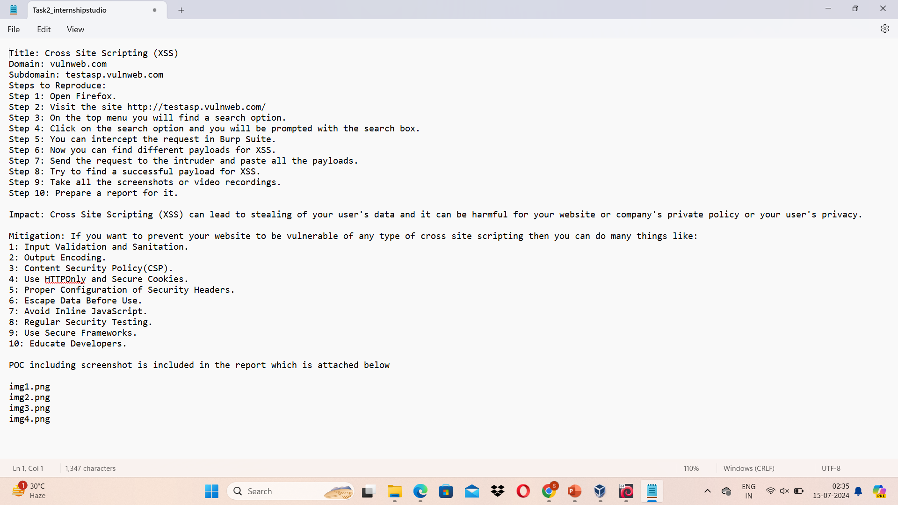

Slide 4
Proof of Concept(POC):-

Slide 5
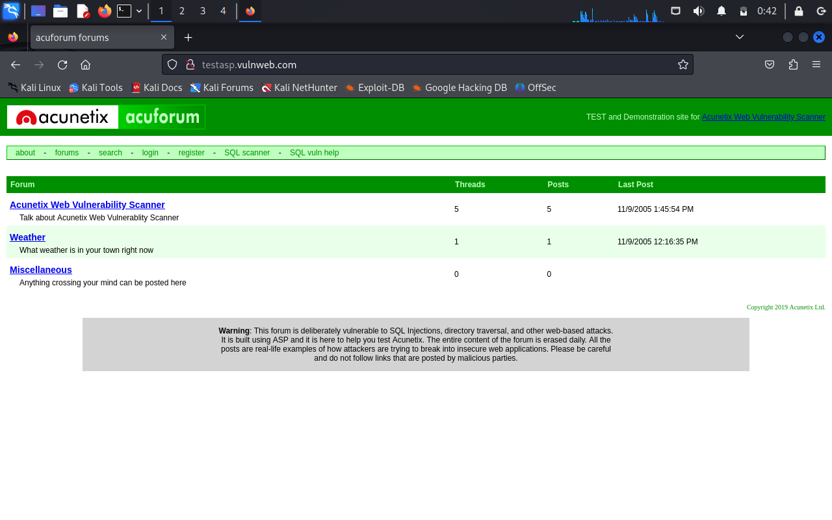

Slide 6
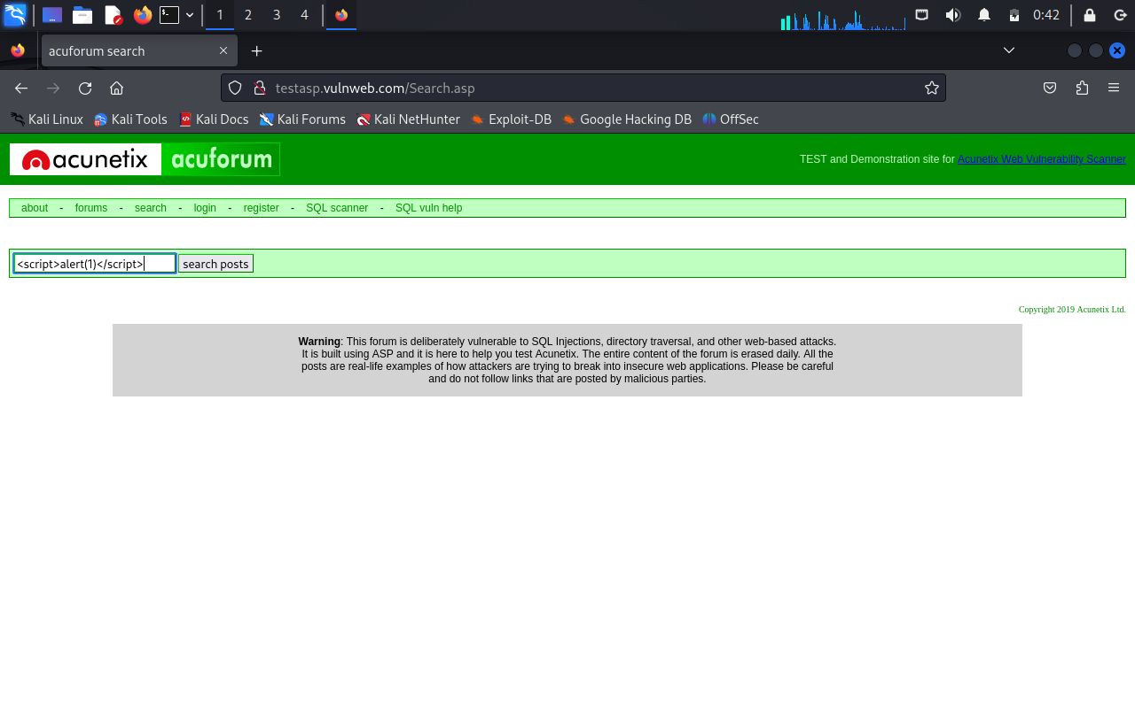

Slide 7
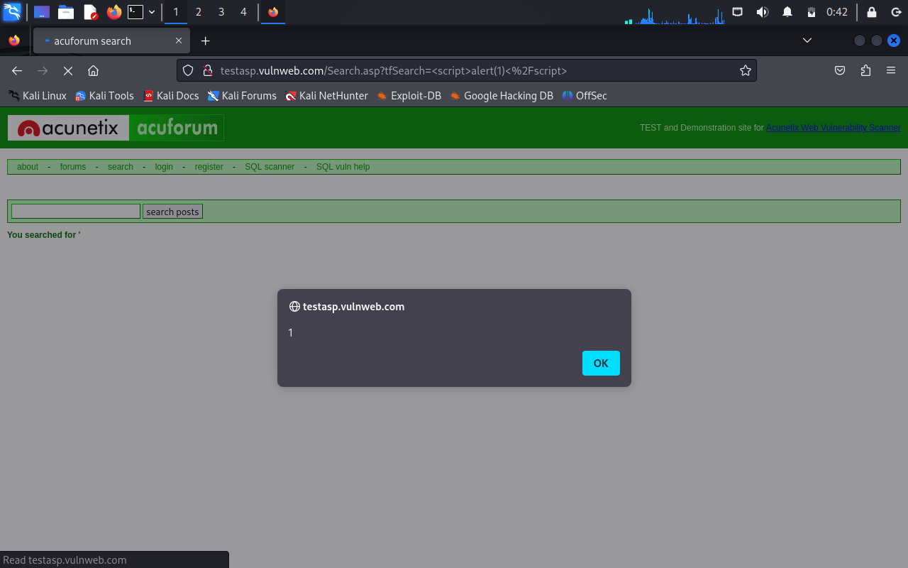

Slide 8
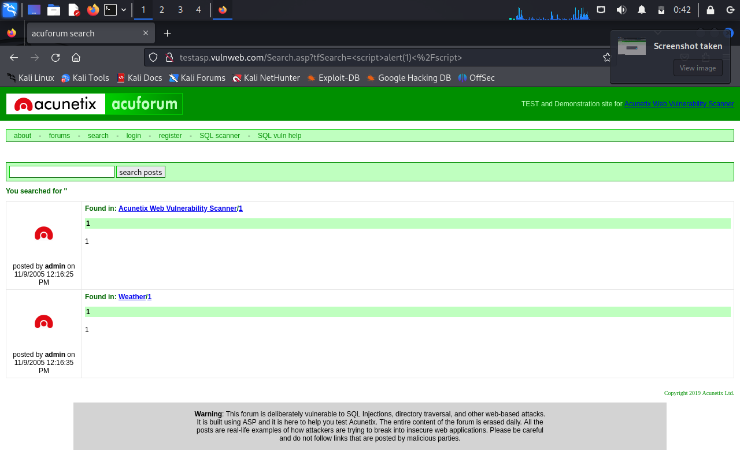

Slide 9
The above are the screenshots of the testasp.vulnweb.com website which is the subdomain of the vulnweb.com . I find some Cross Site Scripting (XSS) vulnerability which leads to stealing the user information or the confidential data of the company/organization. To protect your website you can use the methods mentioned into the report above. That’s the answer of the task 2.

Slide 10
THANKYOU…

